Slide 1


Defense of the
Graduation project
Design and development of an intelligent Recommender System in e-commerce
Elaborated by:
Manel ALOUI
In collaboration with Telnet Holding
Supervisors:
Mme. Nouha KAMOUN Telnet Holding
Dr. Manel BEN ROMDHANE SUP’COM
Major: SCOC
1
Notes:
Good morning my professors, Today I will be defending my graduation project entitled “Design and development of an intelligent Recommender System in e-commerce “ realized in collaboration with Telnet Holding,
First of all I’d like to thank you my professors for accepting to judge my work.
In addition I’m grateful to my supervisor Mme Nouha KAMMOUN for her encouragement and her continuous encouragement, support and help in every step that I take also my academic supervisor doctor manel ben romdhane for her for the kindness and generosity with which she has directed this project.

Slide 2
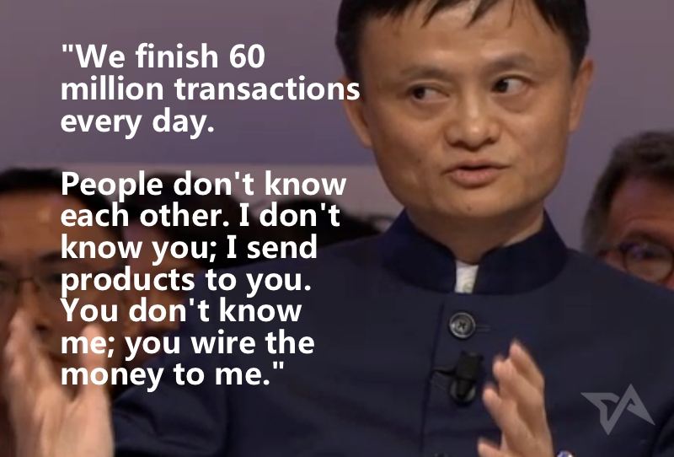

Major: SCOC
21/07/2020
2
1
Notes:
eCommerce is short for Electronic Commerce. It refers to the activity of buying and selling products or services over the internet. like books, electronics, apparel, software, furniture. E-commerce provides a platform for people to buy or sell whatever they want, whenever they want.
Ecommerce is defined as said by Jack Ma : » We finish 60 million transactions every day people don’t know each other. I don’t know you; I send products to you. You don’t know me; you wire the money to me ».
Regarding this growth of e-commerce the main goal is to stay competitive and meet the variety of special needs and tastes of a worldwide market.
This has important consequences for consumers both positives and negatives,

Slide 3


Major SCOC
21/07/2020
3
2
Notes:
In fact they are overwhelmed with choices. Therefore, although a product or service might exist, sometimes it can be really hard to find it.
Related to Steve Jobs :” A lot of times people don’t know what they want until you show it to them.
And here comes in picture the role of recommender system which uses intelligent tools like Machine learning to recommend products to customers.

Slide 4
Smartecom Project
Intelligent Recommender system
Chatbot
Intelligent platform for e-commerce
21/07/2020
3
Notes:
In this context Telnet holding wants to invest in recommender system in a whole project called Smartecom that wants to build an intelligent solution recommender system and chatbots to ease the functionality of an e-commerce website so that they can maintain a dialogue between them in a later stage
My task is to design a framework that develops recommender system based on the state of the art algorithm and uses sentiment analysis to investigate about the feedback of the customer towards a product.

Slide 5
Plan
Overview of recommender system
Latent factor model: Algorithm and results
Sentiment Analysis: Algorithm and results
Conclusion
Perspectives
Major: SCOC
21/07/2020
5
4

Slide 6






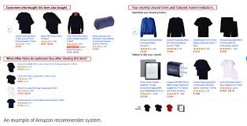
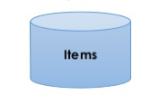
Overview of the project | Latent factor model | Sentiment Analysis | Conclusion | Perspectives
What are recommender system?
Recommendation
Jobs, movies, products…
Major: SCOC
21/07/2020
6
5
Notes:
To begin first we refer a customer as a user and a product as an item, therefore a Recommender system is a intelligent tool that helps users discover items they may like.
We find recommender system in several known platforms and services like linkedin that recommends jobs, Netflix that proposes movies and amazon that gives products.

Slide 7
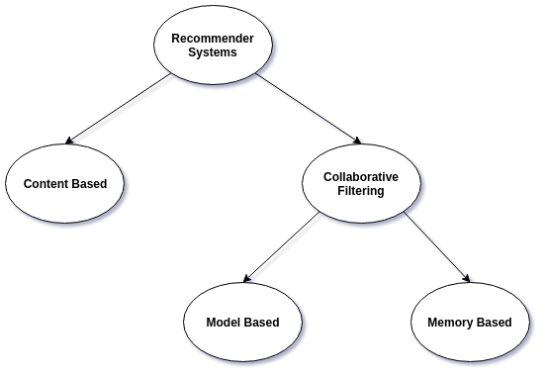
Overview of the project | Latent factor model | Sentiment Analysis | Conclusion | Perspectives
21/07/2020
7
Major: SCOC
6
Notes:
Content-based RecSys is based on product description, it looks about similarities between product with a similarity function and based on results, it recommend items having the high similarity score.
Collaborative filtering: it’s an approach that rely on user item interaction; it’s the most common technique used when it comes to building intelligent recommender systems that can learn to give r recommendations as more information about users is collected.
It can be devided into Memory based which uses user-user similarity or item-item similarity to make recommendations from a ratings matrix, so we need to deter-mine either similar users or similar items in order to make predictions.
and model based in which we can assimilate the recommendation problem into a rating prediction problem

Slide 8
Overview of the project | Latent factor model | Sentiment Analysis | Conclusion | Perspectives
Review text
Recommender system
Sentiment analysis
User behaviour
Recommended item
Good/ Bad item
Major: SCOC
21/07/2020
8
7

Slide 9
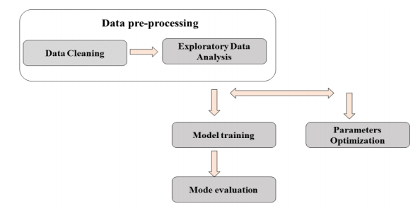
Overview of the project | Latent factor model | Sentiment Analysis | Conclusion | Perspectives
1
2
3
Major: SCOC
21/07/2020
9
7
Notes:
Data pre-processing which is one of the most important steps in machine learning that helps in building ML models more accurately. It consists of dealing with missing values, conversion non numeric data ect.. for Exploratory Data Analysis: In this stage we explore more our data set in order to analyze it and summarize their main characteristics, often with visual methods.
• Model building with parameter optimization: In which we train the model for each approach.
• Model evaluation: For both approaches we used some evaluation metrics to evaluate well our model.

Slide 10
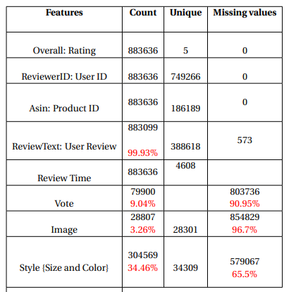
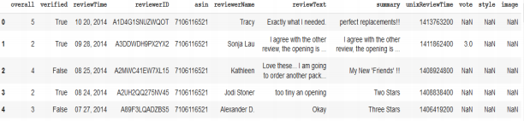
Overview of the project | Latent factor model | Sentiment Analysis | Conclusion | Perspectives
Dataset description
Amazon Review Fashion Data
Checking for NaN values
Delete duplicate values
Do some statistics
Major: SCOC
21/07/2020
10
10
Notes:
We used the data set provided by Amazon which is Amazon Review Data [15] released in 2014. It’s devided into several e-commerce business area such as phones, electronics, homes and kitchen materials, fashion ect... We’ve chosen as sample the fashion sector and it’s just a simple sample and than results and models can be generalized in each domain. In the table above 2.1 only the columns of overall, ReviewerID, asin and ReviewText are almost complete with no missing value just the reviewText with percentage of missing values of 0.06% which is negligible
After checking for NaN values, we than deleted duplicate values. Finally we do some basic statistics like knowing the number of unique users, items and rating already given. For the rating, it consists of numbers in the set { 1,2, 3, 4, 5}. For memory limitation we just consider the 5-core data set of amazon review fashion in which all users and items have at least 5 reviews.

Slide 11
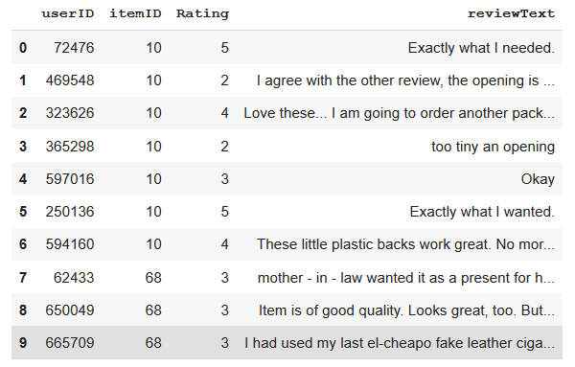
Overview of the project | Latent factor model | Sentiment Analysis | Conclusion | Perspectives
Size: 883636*10
Nb of users: 749232
Nb of items: 186189
Nb of given rating 883636 of 749232*186189
Major: SCOC
21/07/2020
11
11

Slide 12
Overview of the project | Latent Factor Model | Sentiment analysis | Conclusion | Perspectives
Major: SCOC
21/07/2020
12
12

Slide 13
Overview of the project | Latent Factor Model | Sentiment analysis | Conclusion | Perspectives
We need to transform the item rating data frame into an user-item matrix, also called a utility matrix
Items ID
User_id | Item_id | Rating
2 | 439 | 4
10 | 368 | 3
14 | 114 | 5
2 | 371 | 1
19 | 371 | 2
 | 114 | 368 | 371 | 439
2 | ? | ? | 1 | 4
10 | ? | 3 | ? | ?
14 | 5 | ? | ? | ?
19 | ? | ? | 2 | ?
Users ID
→ Here the task is to predict the unknown rating.
Major: SCOC
21/07/2020
13
13
Notes:
latent factor models are the state of the art in recommender system field rely on identifying latent (hidden) factor (features) that affect the user’s preferences
The main idea of LFM is to consider a recommendation as an optimization problem it means we think of it as rating prediction so the optimization here is to find the method that gives us the best rating prediction with the minimum error: the smaller this rating is the better the recommendation.

Slide 14



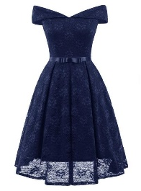


Overview of the project | Latent Factor Model | Sentiment analysis | Conclusion | Perspectives
How to model user-item interactions?
P: latent user matrix (𝒎 × 𝒌 matrix) -> Each user is represented by a latent vector (1 × 𝑘 vector).
Q: latent item matrix (𝒏 × 𝒌 matrix) -> Each item is represented by a latent vector (1 × 𝑘 vector).
User-Item interaction
Major: SCOC
21/07/2020
14
14
Notes:
As mentioned in the report we used matrix factorization as a latent factor machine The basic idea behind matrix factorization is to find two matrices P m*K and Q k*n that multiplied together return a matrix R, which is the original matrix containing all the ratings. P and Q contain the K hidden features

Slide 15
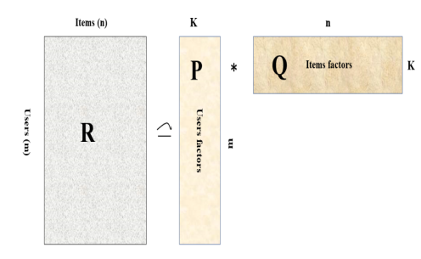
Overview of the project | Latent Factor Model | Sentiment analysis | Conclusion | Perspectives
ˆrui = Predicted rating of user u on item i.
pu = User u factor vector. qi = Item i factor vector.
Major: SCOC
21/07/2020
15
15
Notes:
t for a given user u exist a vector pu which measures the interest of that user u in the available items, Similarly, for an item i there is a vector qi that measures the relevance of this item amongst the users. Therefore the resulting dot product qiÖpu captures the interaction between user u and the item i [9]. The main benefit of this method is that by capturing the overall interest of user u in the item i, we can approximate the user u’s rating rui ˆ towards that item i.
To sum up the main challenge is to compute the mapping between users and items to the latent factors qi and pu the main goal behind MF is to predict the ratings which is the dot product between p and q. where: ˆrui = Predicted rating of user u on item i. pu = User u factor vector. qi = Item i factor vector.

Slide 16
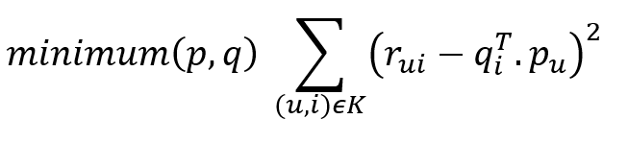
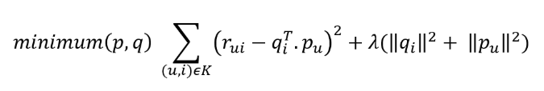
Overview of the project | Latent Factor Model | Sentiment analysis | Conclusion | Perspectives
To generalize well and not over-fit the training set, we add a penalty term to our minimization equation.
This is represented by a regularization factor λ multiplied by the square sum of the magnitudes of user and item vectors.
Loss function
Major: SCOC
21/07/2020
16
16

Slide 17

Overview of the project | Latent Factor Model | Sentiment analysis | Conclusion | Perspectives
Pseudocode for SGD in matrix factorization
1/ Randomly initialize all vectors pu and qi , each of size k
2/ for a given number of times (i.e. number of epochs), repeat:
• for all known ratings rui , repeat:
• compute the derivative of the squared error eui = rui • update pu and qi with the rule presented above
→ Find pu and qi that minimize the loss function
Regularization factor
Learning rate
Major: SCOC
21/07/2020
17
17
Notes:
From a high level perspective SGD starts by giving the parameters of the equation we are trying to minimize initial values and then iterating to reduce the error between the predicted and the actual value each time correcting the previous value by a small factor. This algorithm uses a factor called learning rate γ which determines the ratio of the old value and the new computed value after each iteration.

Slide 18
Overview of the project | Latent Factor Model | Sentiment analysis | Conclusion | Perspectives
Grid search for hyper-parameter optimization
hyper-parameter | Definition | Range
K | Number of latent factors | [10, 20, 50, 100, 130, 150, 200]
Epochs | Number of iteration | [10, 15, 30, 100]
γ | Learning rate | [0.001, 0.005, 0.007, 0.01, 0.05, 0.07, 0.1]
λ | Regularization factor | [0.01, 0.05, 0.07, 0.1, 0.2, 0.4, 0.6]
Major: SCOC
21/07/2020
18
18

Slide 19
Overview of the project | Latent Factor Model | Sentiment analysis | Conclusion | Perspectives
Major: SCOC
21/07/2020
19
19

Slide 20

Overview of the project | Latent Factor Model | Sentiment analysis | Conclusion | Perspectives
Evaluation metric
Where ψ is the set of indices of available ratings and |ψ| is the cardinality of the rating dataset i.e. number of available ratings.
Major: SCOC
21/07/2020
20
20
Notes:
To evaluate MF results, we use the root mean squared error (RMSE). RMSE stands for Root Mean Squared Error is typically used to evaluate regression problems where the output (a predicted scalar value) is compared with the true scalar value output for a given data point. It is computed as follows:

Slide 21
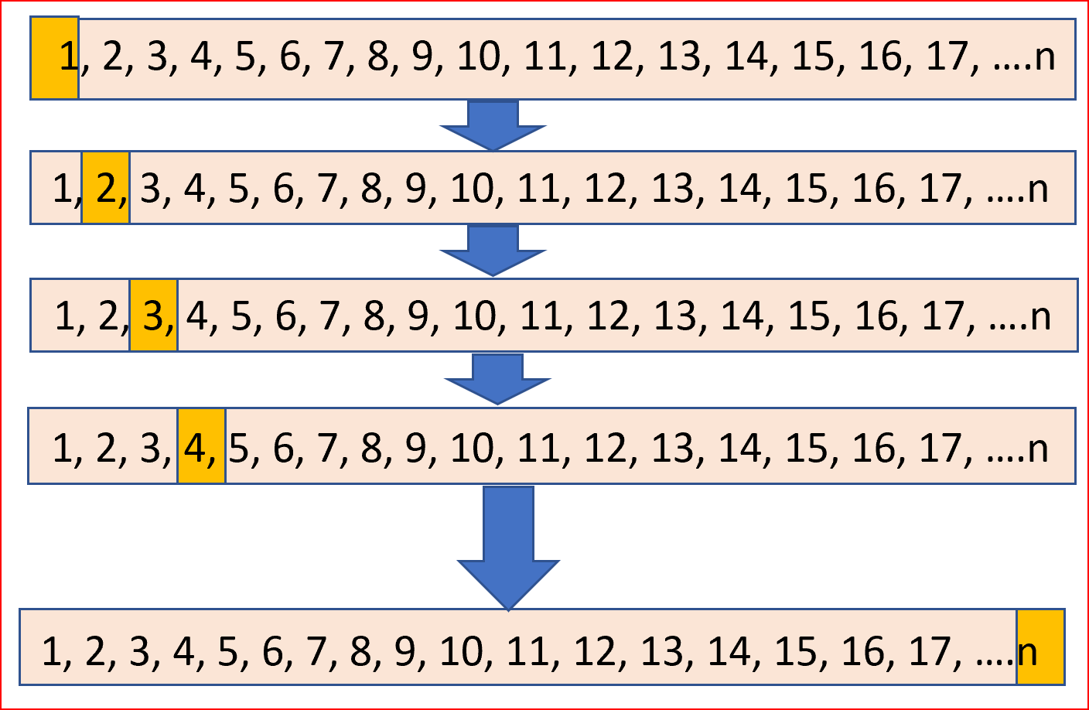
Overview of the project | Latent Factor Model | Sentiment analysis | Conclusion | Perspectives
Split the data
Major: SCOC
21/07/2020
21
21
Notes:
In LOOCV we divide the data set into two parts. In one part we have a single observation, which is our test data and in the other part, we have all the other observations from the dataset forming our training data.
If we have a data set with n observations then training data contains n-1 observation and test data contains 1 observation.
This process is iterated for each data point as shown below. Repeating this process n times generates n times Root Mean Square Error(RMSE)

Slide 22
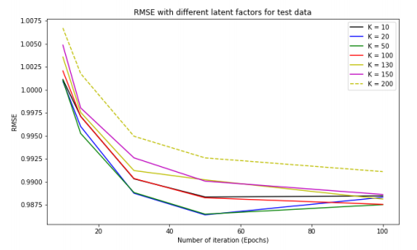
Overview of the project | Latent Factor Model | Sentiment analysis | Conclusion | Perspectives
Experimental results:
Hyper-parameters | Value
Number of iteration | 50
Number of latent factor | 50
Learning rate | 0.005
Regularization factor | 0.01
RMSE: 0.986
Epochs: 50
Major: SCOC
21/07/2020
22
22

Slide 23
Overview of the project | Latent factor model | Sentiment analysis | Conclusion | Perspectives
Review text
Recommender system
Sentiment analysis
User behaviour
Recommended item
Good/ Bad item
Major: SCOC
21/07/2020
23
7

Slide 24
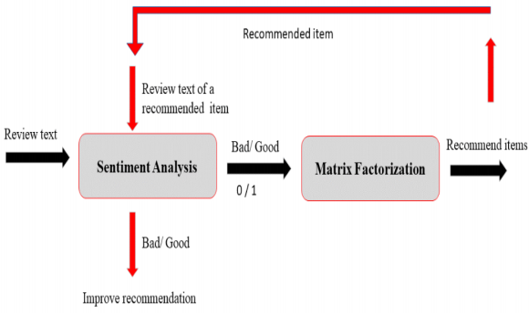
Overview of the project | Latent factor model | Sentiment analysis | Conclusion | Perspectives
Major: SCOC
24
21/07/2020
24

Slide 25
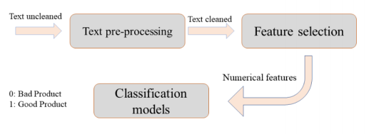
Overview of the project | Latent factor model | Sentiment analysis | Conclusion | Perspectives
To reduce computational time we convert our classification problem from multi-class {1, 2, 3, 4, 5}classification to binary classification {0,1} as follows: 1, 2 → Bad rating :0
3, 4, 5 → Good rating: 1
200 000 review text from 883636
Major: SCOC
21/07/2020
25
25

Slide 26
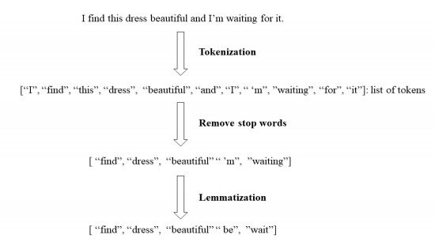
Overview of the project | Latent factor model | Sentiment analysis | Conclusion | Perspectives
Sparql1.1
Major: SCOC
21/07/2020
26
26

Slide 27
Overview of the project | Latent factor model | Sentiment analysis | Conclusion | Perspectives
Major:SCOC
21/07/2020
27
27

Slide 28
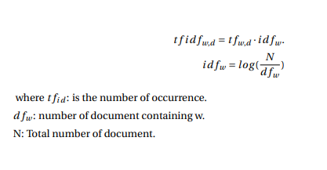
Overview of the project | Latent factor model | Sentiment analysis | Conclusion | Perspectives
Feature selection
TFIDF-Vectorizer
Major: SCOC
21/07/2020
28
28

Slide 29
Overview of the project | Latent factor model | Sentiment analysis | Conclusion | Perspectives
Major: SCOC
21/07/2020
29
29

Slide 30
Overview of the project | Latent factor model | Sentiment analysis | Conclusion | Perspectives
Split the data
Training Data
Test Data
80%
20%
Major: SCOC
21/07/2020
30
30
Notes:
Baseline algorithm based on the Bayes Theorem.
• Represent a document X as a set of pairs.
• For each label y, build a probabilistic model P(X| Y = y) of documents in class y.
• To classify, select label y which is most likely to generate X
the logistic model is a statistical model that is usually taken to apply to a binary dependent variable
The algorithm itself simply models probability of output in terms of input
The algorithm itself simply models probability of output in terms of input, and does not perform statistical classification (it is not a classifier), though it can be used to make a classifier, for instance by choosing a cut-off value and classifying inputs with probability greater than the cut-off as one class, below the cut-off as the other

Slide 31
Overview of the project | Latent factor model | Sentiment analysis | Conclusion | Perspectives
Naïve Bayes
Baseline algorithm based on the Bayes Theorem.
Represent a document X as a set of pairs.
For each label y, build a probabilistic model P(X| Y = y) of documents in class y.
To classify, select label y which is most likely to generate X
The binary logistic model is used to estimate the probability of a binary response based on one or more predictor
.The algorithm itself simply models probability of output in terms of input.
Use the sigmoid function to fix the cut-off.
Logistic regression
Major: SCOC
21/07/2020
31
31
Notes:
Baseline algorithm based on the Bayes Theorem.
• Represent a document X as a set of pairs.
• For each label y, build a probabilistic model P(X| Y = y) of documents in class y.
• To classify, select label y which is most likely to generate X
the logistic model is a statistical model that is usually taken to apply to a binary dependent variable
The algorithm itself simply models probability of output in terms of input
The algorithm itself simply models probability of output in terms of input, and does not perform statistical classification (it is not a classifier), though it can be used to make a classifier, for instance by choosing a cut-off value and classifying inputs with probability greater than the cut-off as one class, below the cut-off as the other

Slide 32
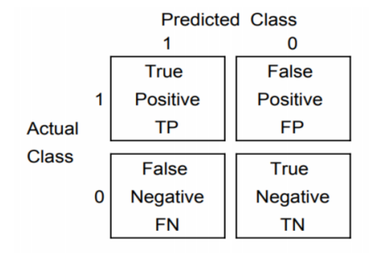
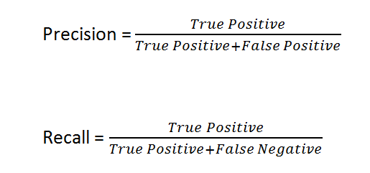

Overview of the project | Latent factor model | Sentiment analysis | Conclusion | Perspectives
Evaluation metrics for text classification
Confusion matrix
Precision/ Recall
F1 score
Major: SCOC
21/07/2020
32
32
Notes:
True positive (TP), the algorithm classifies 1 where the correct class is 1.Good review text correctly identified 2. False positive (FP), the algorithm classifies 1 where the correct class is 0. review text incorrectly classified as good feedback. 3. True negative (TN): the algorithm classifies 0 where the correct class is 0.:review text correctly classified as bad. 4. False negative (FN), the algorithm classifies 0 where the correct class is 1: review text incorrectly classified as bad feedback.
While recall expresses the ability to find all relevant instances in a dataset, precision expresses the proportion of the data points our model says was relevant actually were relevant

Slide 33
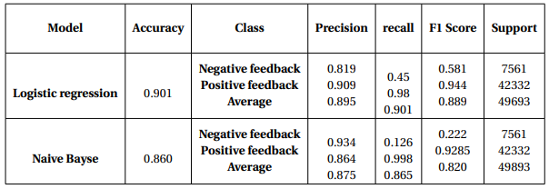
Overview of the project | Latent factor model | Sentiment analysis | Conclusion | Perspectives
Experimental results:
Major: SCOC
21/07/2020
33
33

Slide 34



Overview of the project | Latent factor model | Sentiment analysis | Conclusion | Perspectives
Implementation tools
Major: SCOC
21/07/2020
34
34

Slide 35
Overview of the projetc | Latent factor model | Sentiment analysis | Conclusion | Perspectives
A latent factor model is based on extracting hidden features
Design and build a latent factor model using the surprise package
Use of Grid Search to find the best hyper-parameters → RMSE 0.986
Use review text to build a text classifier to predict the feedback of the user towards an item
Get good results with Logistic regression with accuracy = 0.901
Major SCOC
21/07/2020
35
35

Slide 36
Overview of the Project | Latent factor model | Sentiment analysis | Conclusion | Perspectives
Build a deep neural network for the task of matrix factorization.
Try the technique of Boltzmann Machine to predict the rating.
Test results with encoders and decoders.
For the sentiment analysis try the unsupervised machine learning approach
Use neural network for classification to improve results
Combine the sentiment analysis with the recommender system to boost the business profit.
Major: SCOC
21/07/2020
36
36

Slide 37

Questions
Thank you for your attention
Major: SCOC
21/07/2020
37
37

Slide 38
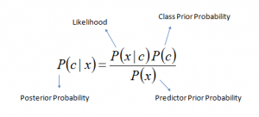
Annex
Naïve Bayes
P(c|x) is the posterior probability of class (c, target) given predictor (x, attributes).
P(c) is the prior probability of class.
P(x|c) is the likelihood which is the probability of predictor given class.
P(x) is the prior probability of predictor.
Major: SCOC
21/07/2020
38
38

Slide 39
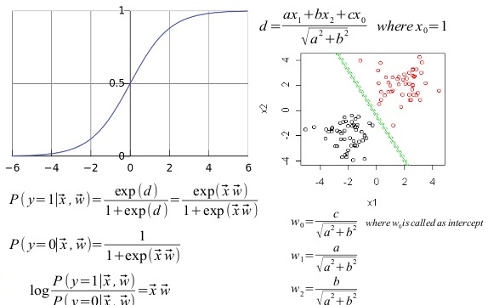
Annex
Logistic regression
Major: SCOC
21/07/2020
39
39

